Slide 1
Class Five
Review, Return Methods, Arrays

Slide 2
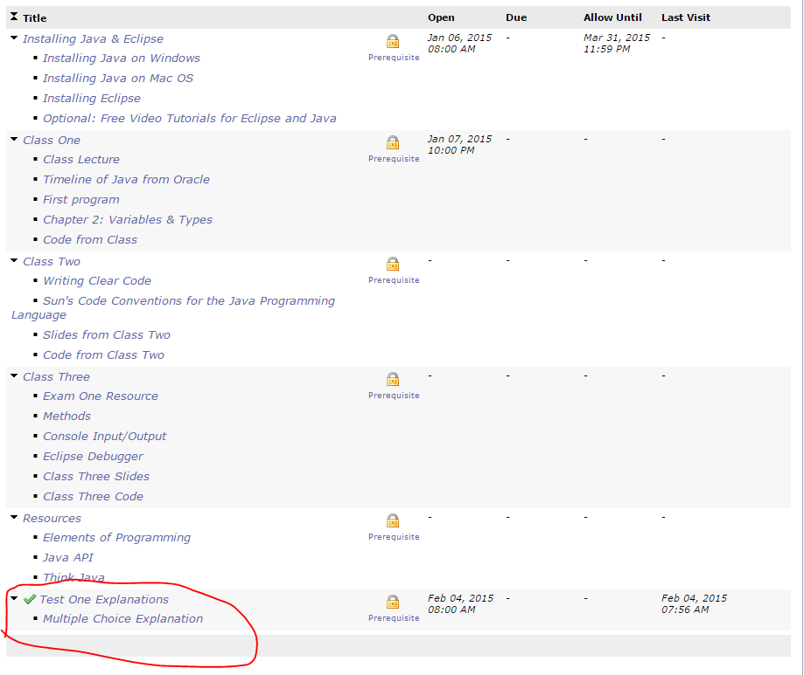
Exams & Grading
Hope to have everything graded by the end of the weekend.
  Pset 1, 2 & take home
Explanation of MC in a video on youtube
  Still have questions? Email or ask me next week
  Give me feedback on the video if you have any!
Notes:
https://www.youtube.com/watch?v=wCoA1g5Z06E&feature=youtu.be

Slide 3
Free Response Question
Before we do it, let’s review!

Slide 4
Review
Class, main(), variables, methods, console i/o

Slide 5
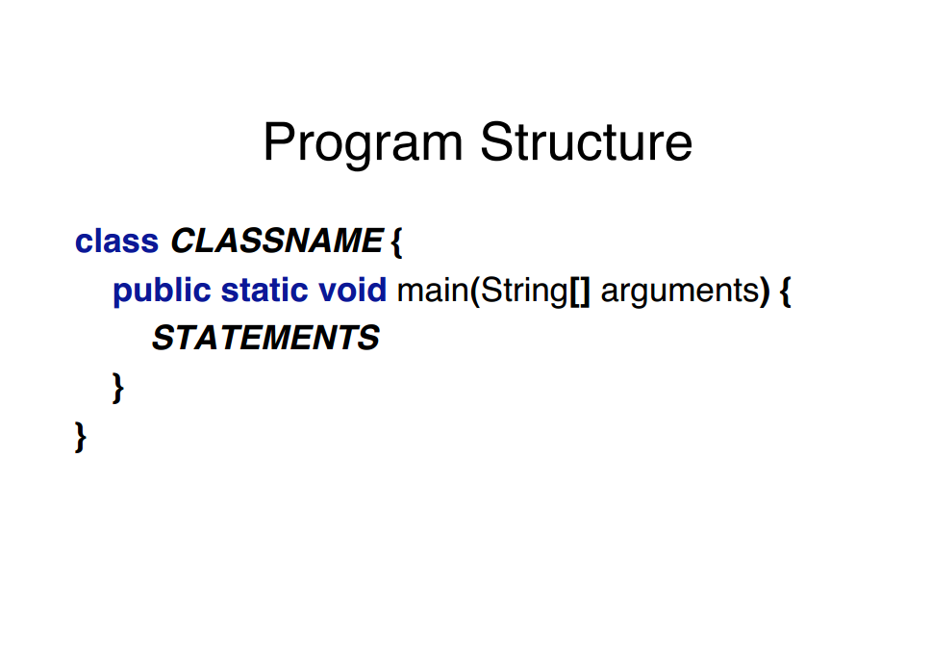

Slide 6
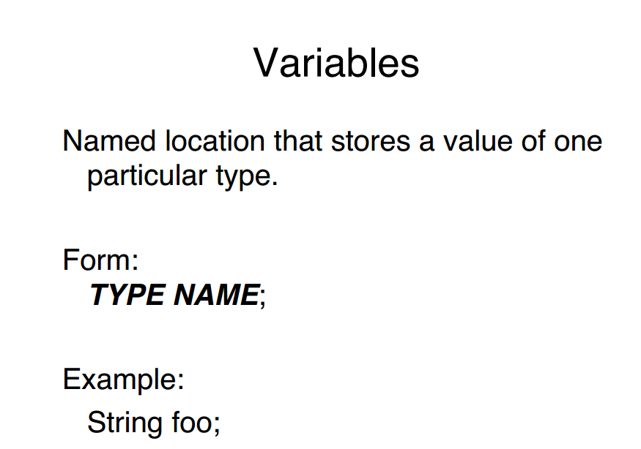

Slide 7
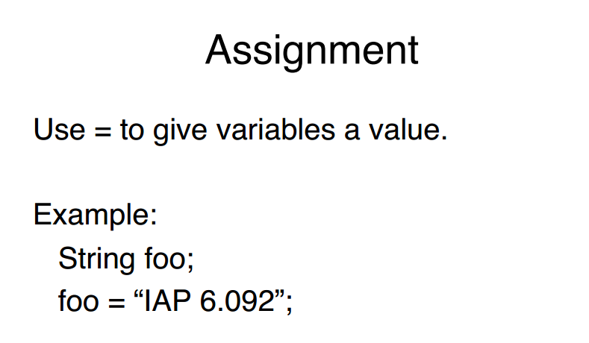
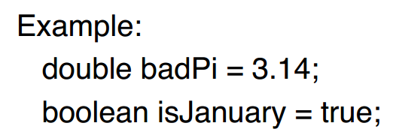
false;
Foooooo fooo

Slide 8

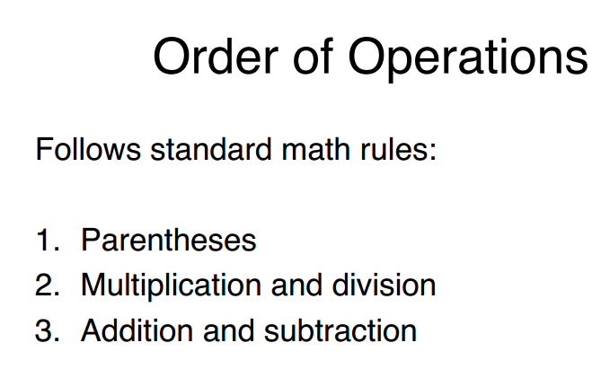
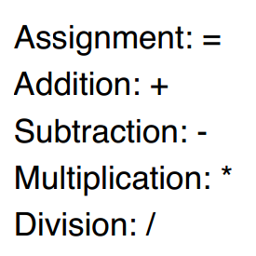

Slide 9
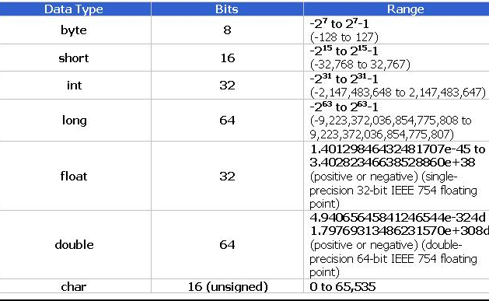
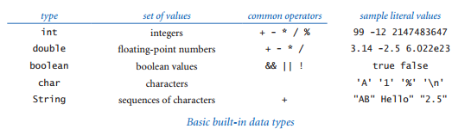

Slide 10
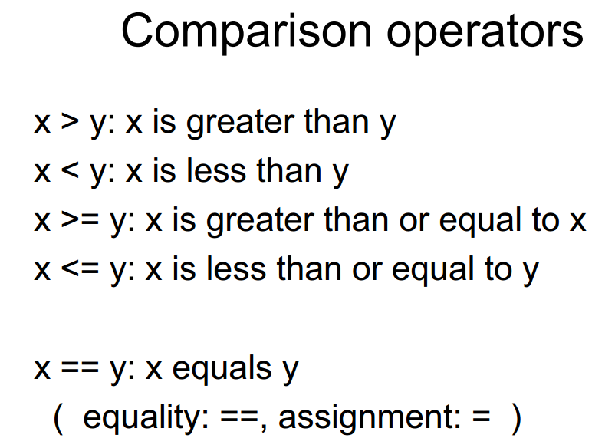

Slide 11
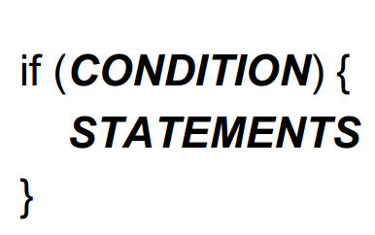
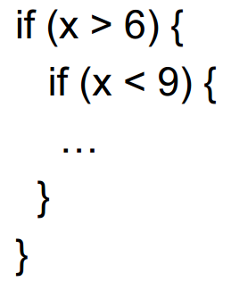

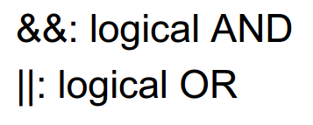
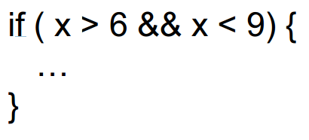

Slide 12
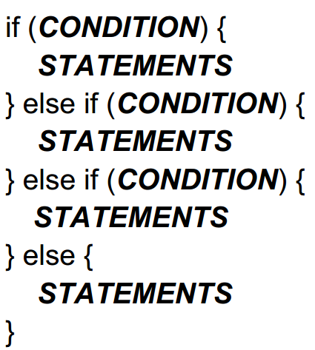
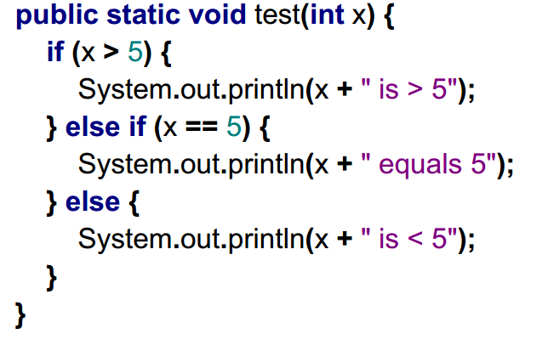
Notes:
Don’t forget the else

Slide 13
While Loops
while loop has the same form as the if statement
while (<boolean expression>) {
//statements
}
Same as writing if statement the number of times it runs
if(<boolean expression>) { //statements }
if(<boolean expression>) { //statements }
if(<boolean expression>) { //statements }
if(<boolean expression>) { //statements }
Notes:
One of the basic Java constructs for handling that situation is while loops.
Has the same form, but the function/meaning is very different
If the expression is false, do nothing (same as an if statement)
If the expression is true, execute the sequence of statements (just as
with if) but then check the expression again, execute the sequence of statements
again if the expression is true, and continue as long as the expression is true.
As with the if statement, the braces are optional if a while loop body has just one statement.

Slide 14
For loops
<initialize>;
while (<boolean expression>)
{
<statements>
<increment>;
}
Turns into
for (<initialize>; <boolean expression>; <increment>){
//statements
}
Notes:
an alternate Java construct that allows us even more flexibility when writing programs with loops. This alternate notation is not fundamentally different from the basic while loop, but it is widely used because it often allows us to write more compact and more readable programs than if we used only while statements.

Slide 15
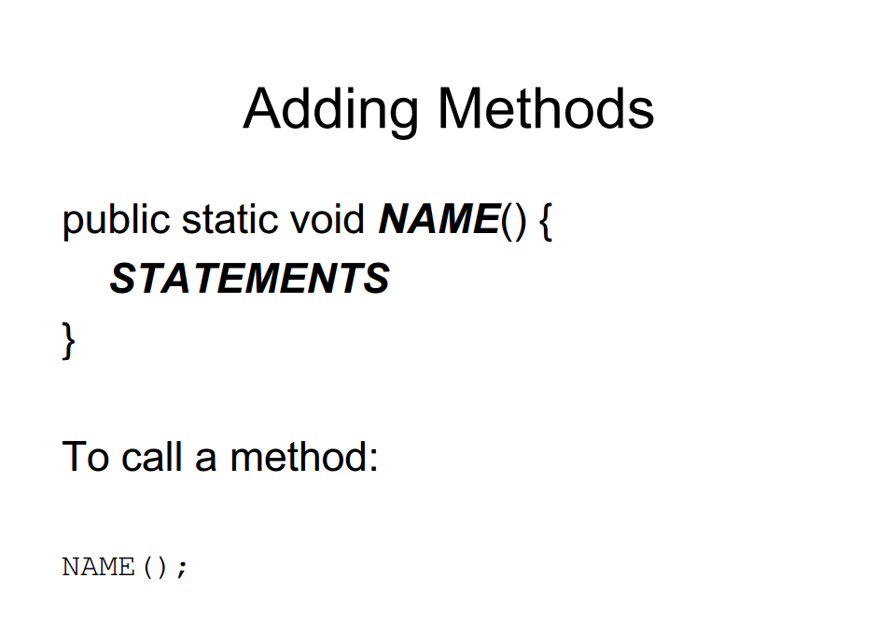

Slide 16
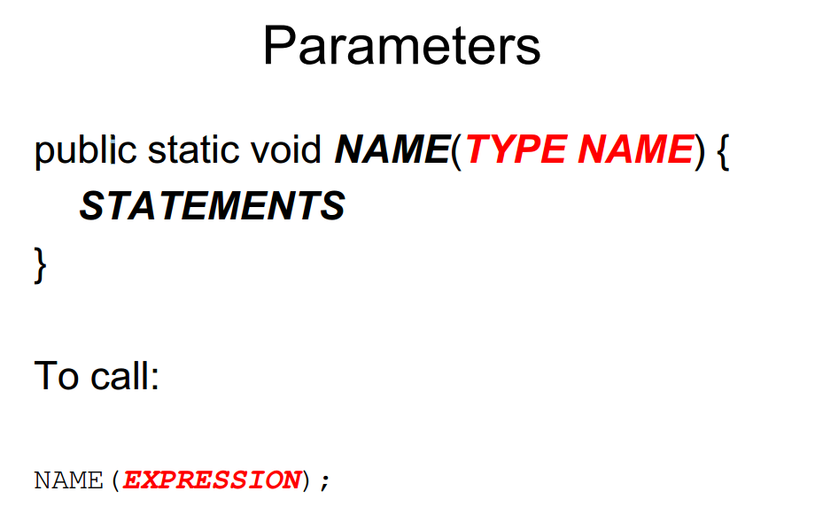

Slide 17
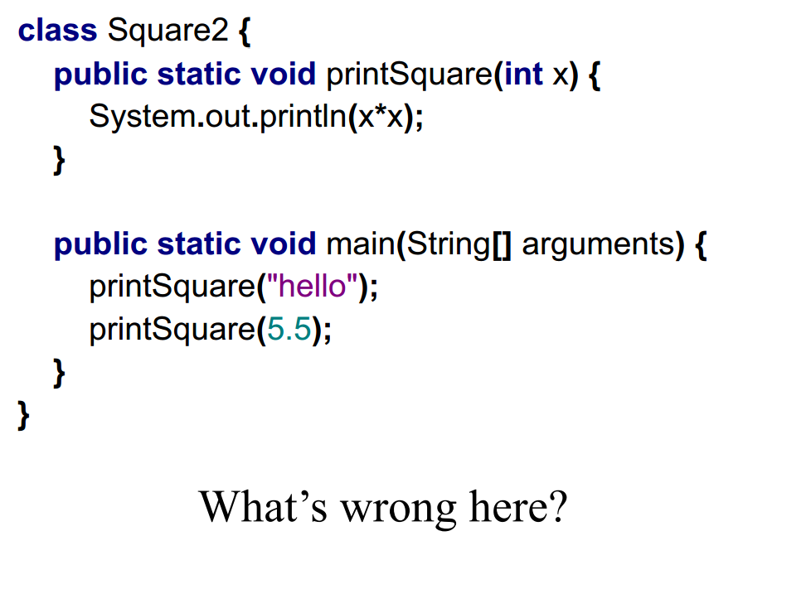

Slide 18
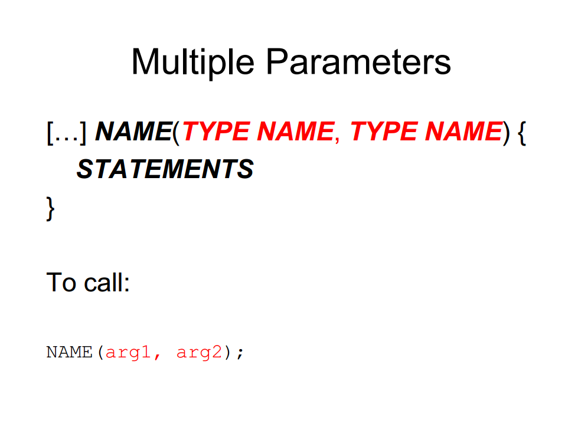

Slide 19
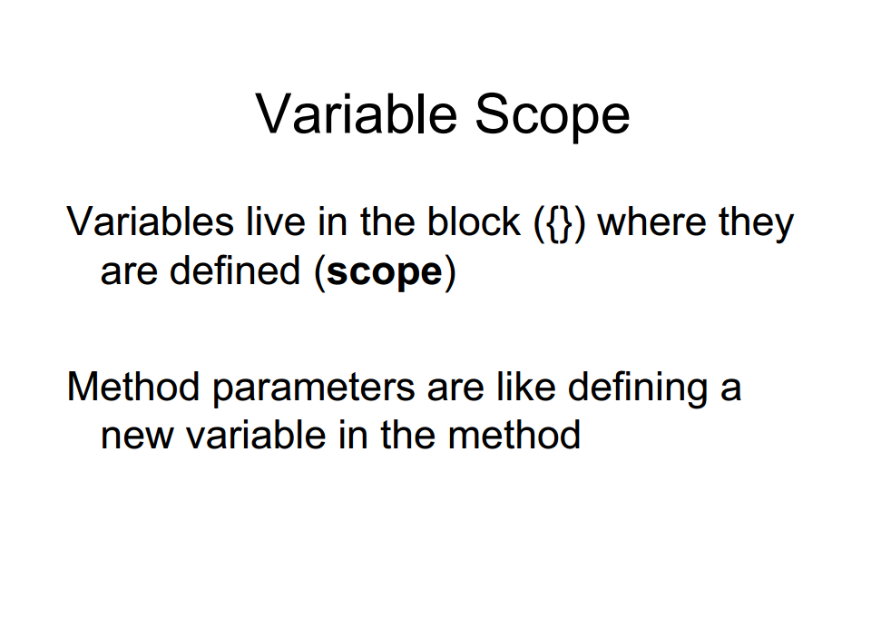

Slide 20
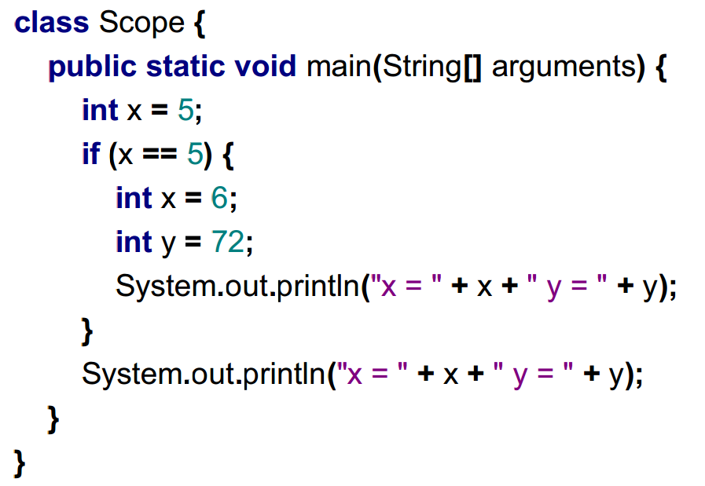


Slide 21
Scope Exercise
The following code doesn’t work. Fix it:
public static void test1()
{
int i;
for (i=0; i < 10; i++) {
if (Math.sqrt(i) > 2.5)
break;
}
System.out.println(i);
}

Slide 22
Scope Exercise Two
The following code doesn’t work. Fix it:
public static void test2() {
int i= 4;
int i6;
if (i*i > 6) {
i6= i;
}
int i7= i6 + 2;
}

Slide 23
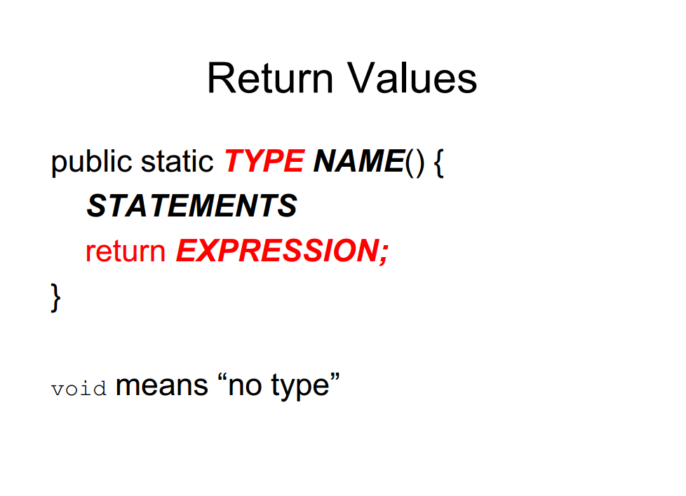
Notes:
Some of the methods we are using, like the Math methods, return values.
so far all our methods have been void; that is, methods that return no value. When you invoke a void method, it is typically on a line by itself, with no assignment:
countdown(3); nLines(3);
In this chapter we write methods that return things
The first thing you should notice is that the beginning of the method definition is different. Instead of public static void, which indicates a void method, we see public static double, which means that the return value from this method is a double. I still haven’t explained what public static means, but be patient.

Slide 24
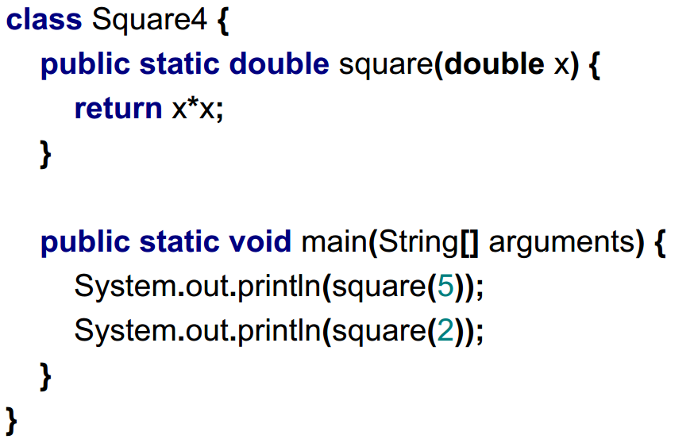

Slide 25
Quick Exercise
Write a method named isDivisible that takes two integers, n and m and that returns true if n is divisible by m and false otherwise.

Slide 26
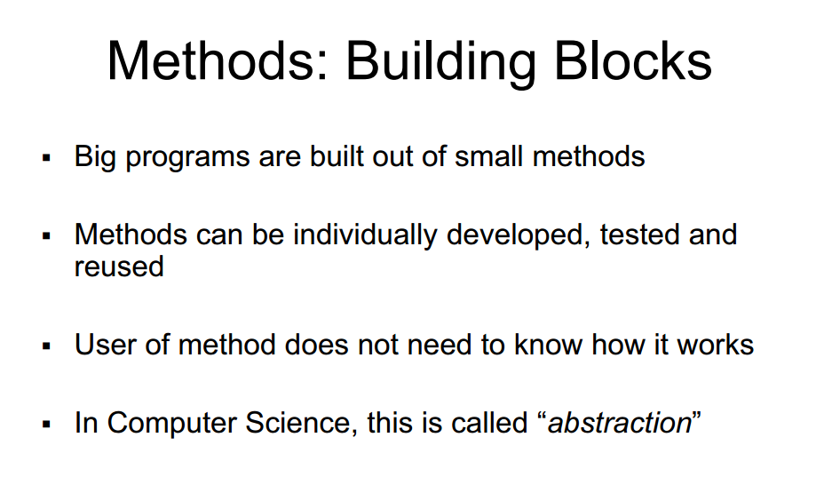

Slide 27
Free Response Question
Now that we have reviewed, let’s do some questions. Starting with the question from the exam:
This method will accept two parameters and compute the value of the first parameter raised to the power of the second parameter. For example, calling raiseToPower(2.0, 3) would return 2³ = 8. The exponent can be either positive or negative, so calling raiseToPower(0.5, -2) should yield 0.5⁻² = 4. For the purposes of this assignment, we'll assume that any number raised to the zeroth power will be 1.
private double raiseToPower(double base, int exponent)
Notes:
public static double power(double x, int n)
{
double result = 1.0;
while (n > 0) {
result *= x;
n--;
}
return result;
}

Slide 28
BREAK

Slide 29
Arrays
An array is an indexed list of values.
You can make an array of any type int, double, String, etc.
All elements of an array must have the same type.
Notes:
An array is a set of values where each value is identified by an index. You can make an array of ints, doubles, or any other type, but all the values in an array have to have the same type.
Syntactically, array types look like other Java types except they are followed by []. For example, int[] is the type “array of integers” and double[] is the type “array of doubles.”
The primary purpose of an array is to facilitate storing and manipulating large quantities of data.
An array stores a sequence of values that are all of the same type.

Slide 30
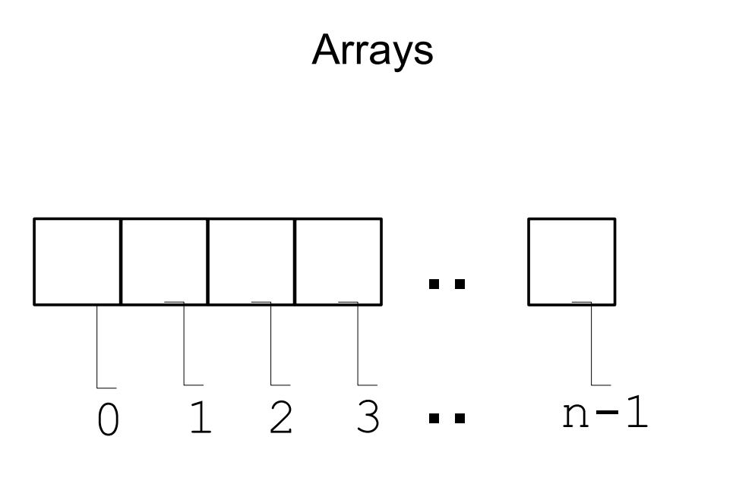

Slide 31
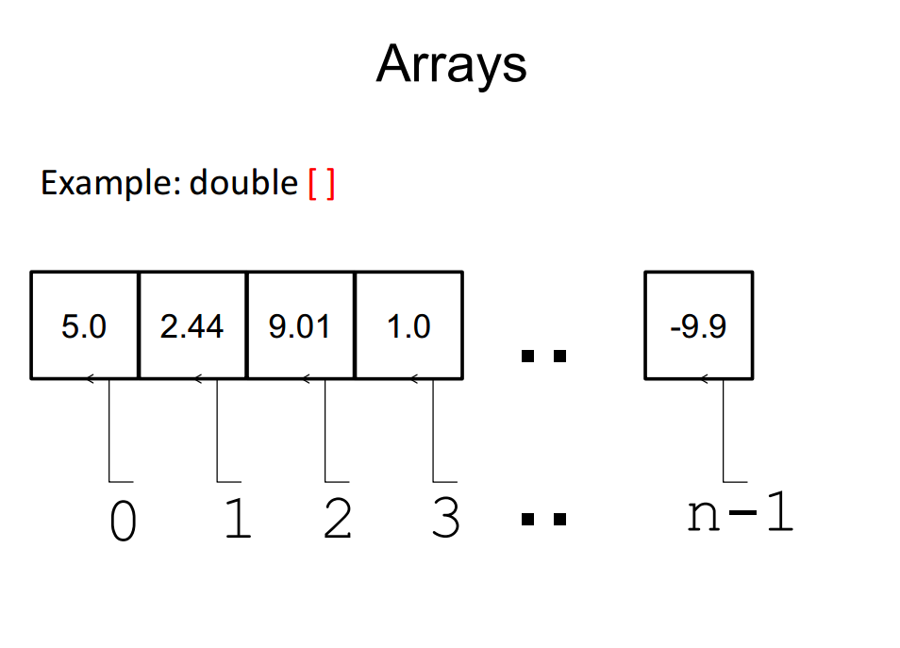

Slide 32
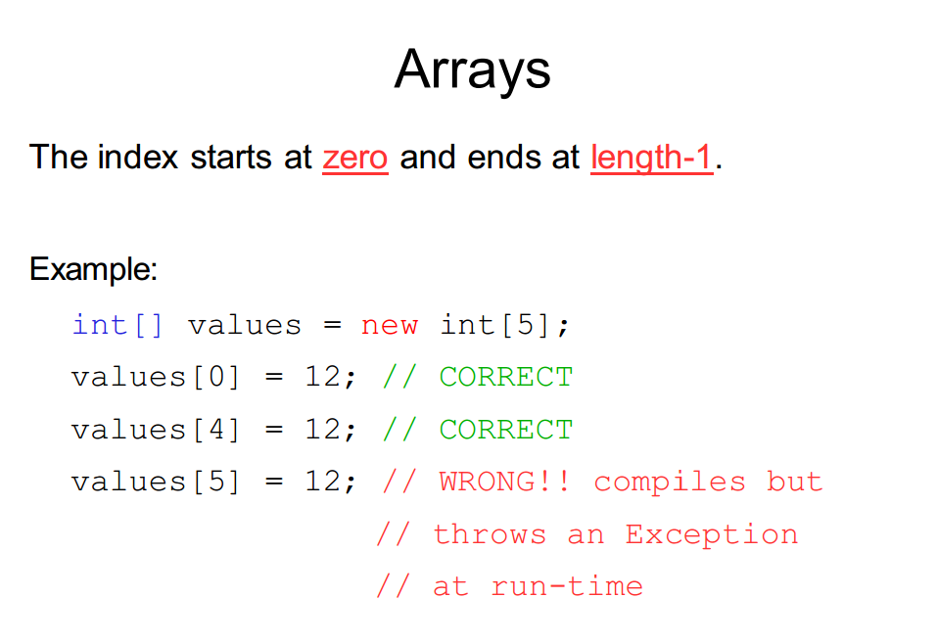

Slide 33
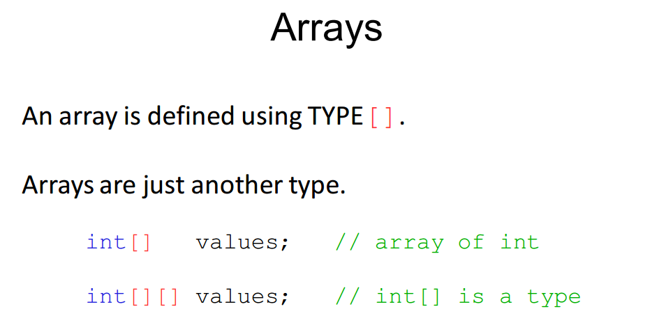

Slide 34
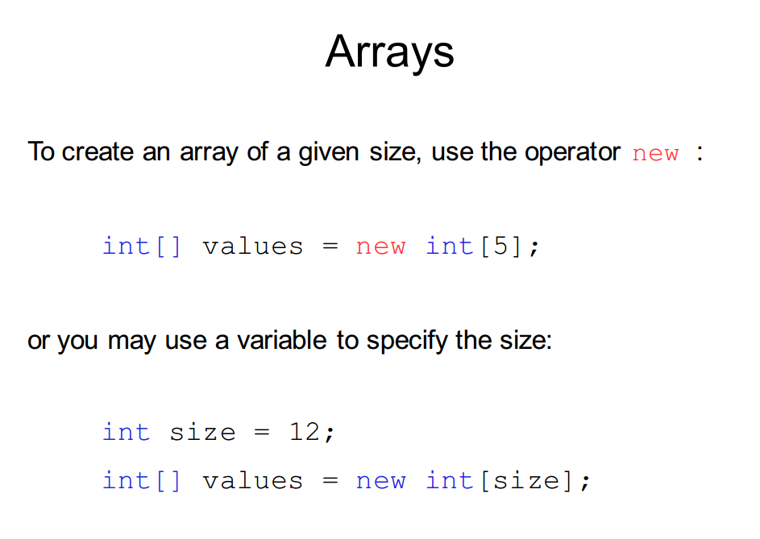

Slide 35
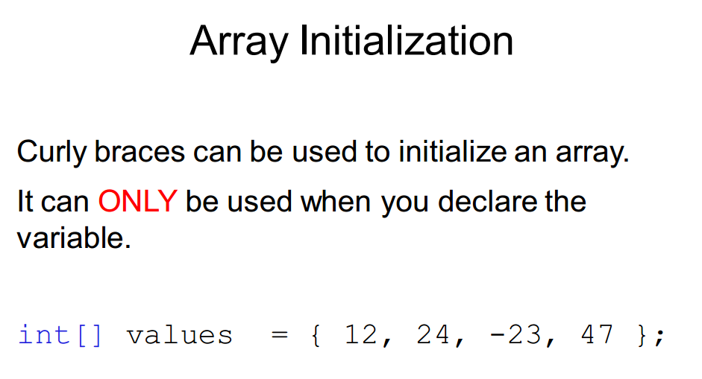

Slide 36
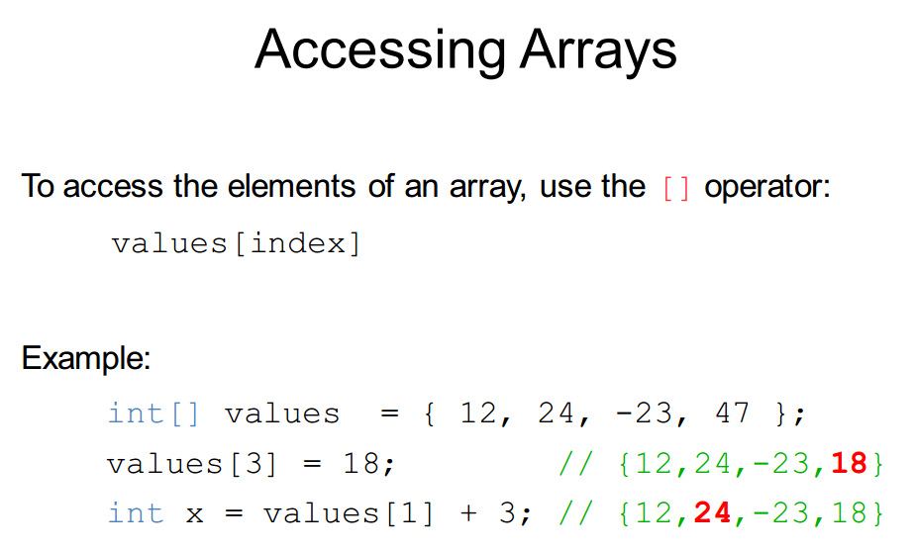

Slide 37
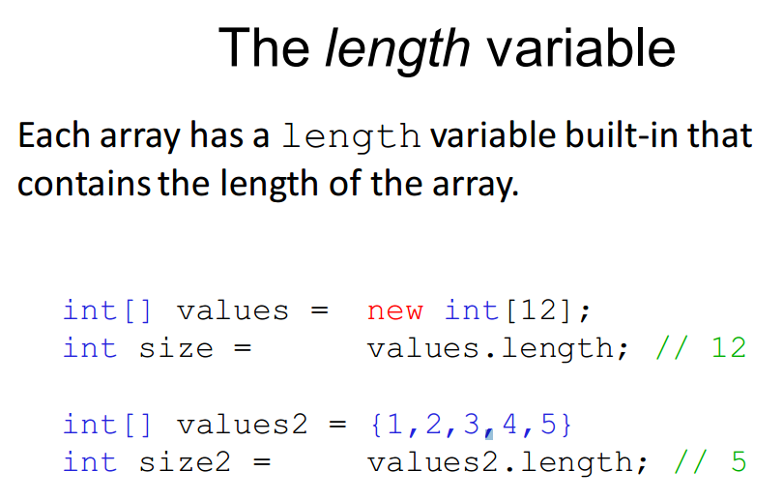

Slide 38
Understanding Code
public class Array-Declarations {
public static void main(String [] args) {
int [] w;
int [] x = null;
int [] y = new int[3];
int [] z = {1, 3, 5, 7, -14};
}
}

Slide 39
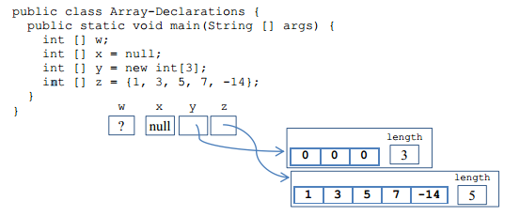
Understanding Code

Slide 40
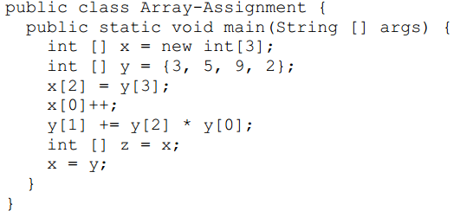
Understanding Code

Slide 41
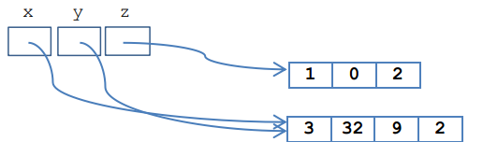
Understanding Code

Slide 42
Combining Loops & Arrays

Slide 43
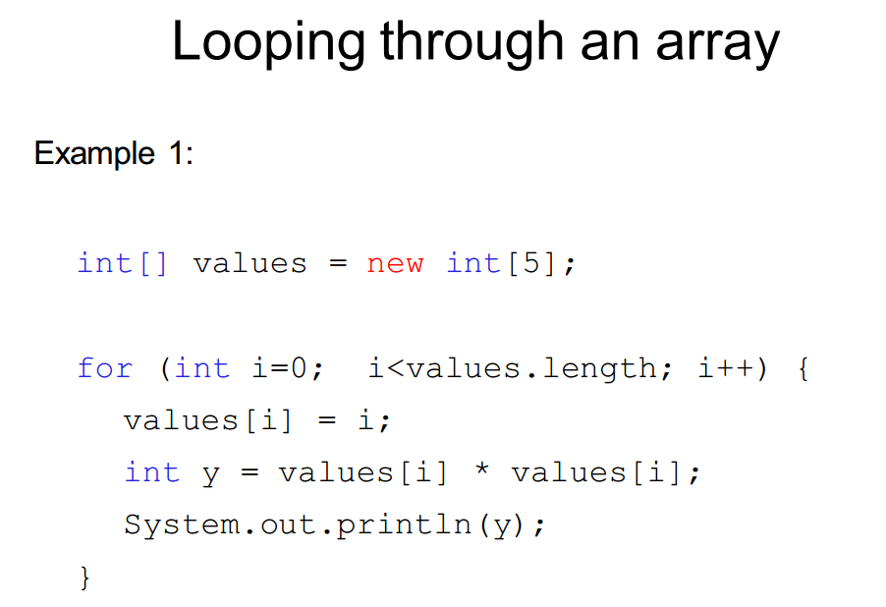

Slide 44
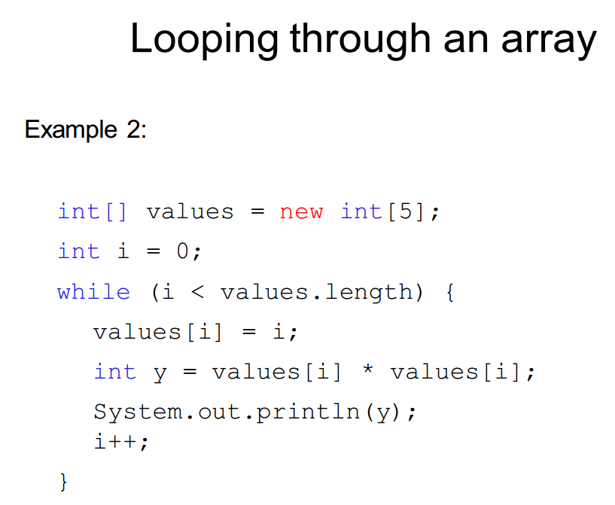

Slide 45
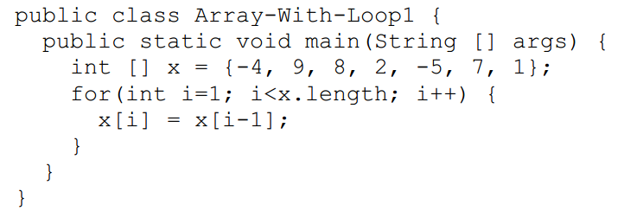
Understanding Code

Slide 46
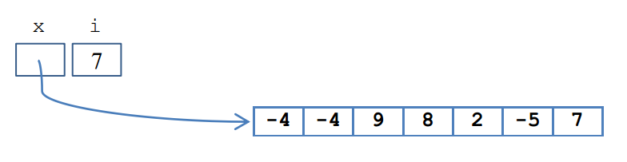
Understanding Code

Slide 47
Array Exercise
Write a method makeRandom(int n) that returns an array of n random numbers
Will get random numbers using Math.random();

Slide 48
Array Exercise
Write a program that reads in 10 temperature values (as doubles) for 10 days of weather, computes the average temperature, and displays the number of days that were hotter than the average.
Notes:
Hint: use two accumulate loops, one to compute the sum of the array of temperatures, and one to compute the number of days above average.
import java.util.Scanner; public class DaysAboveAverage { public final int NUM_DAYS = 10; public static void main(String [] args) { Scanner keyboard = new Scanner(System.in); double [] store = new double[NUM_DAYS]; // sum algorithm double sum = 0; for(int i=0; iavg) { count++; } } System.out.println("avg temp = " + avg + " and " + count + " days above avg"); }

Slide 49
More Exercises?
Read in 10 ints from the keyboard, and store them in an array. Find the position (or index) of the maximum and minimum values in the array, and swap them (move the biggest element to the position of the smallest, and move the smallest element to the position of the biggest).
Notes:
Write a function that concatenates two lists.
Write a function that tests whether a string is a palindrome.
http://adriann.github.io/programming_problems.html
ftp://ftp.fixme.ch/free_for_all/Ebook/IT%20eBooks/Software%20Engineering/Best%20Practices%20%28Language%20Neutral%29/Personal%20%28Career%20Advice%29/Programming%20Interviews%20Exposed.PDF
Reverse elements in array
http://chortle.ccsu.edu/Java5/Notes/chap47/progExercises47.html
Exercise 3 — Three Arrays
Examine the following program:
class Exercise3 { public static void main ( String[] args ) { int[] valA = { 13, -22, 82, 17}; int[] valB = {-12, 24, -79, -13}; int[] sum = { 0, 0, 0, 0}; // Add values from corresponding cells of valA and valB // and put the result in the corresponding cell of sum. System.out.println( "sum: " + sum[0] + " " + sum[1] + " " + sum[2] + " " + sum[3] ); } }

Slide 50
Classroom Quiz

Slide 51
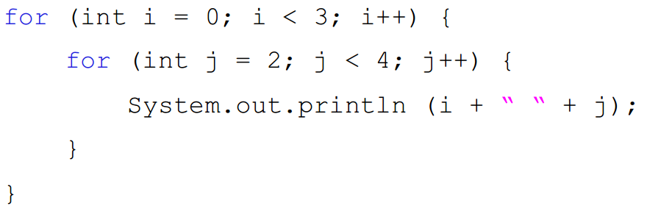
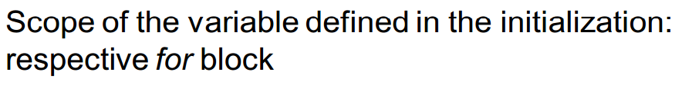
Nesting
Use indenting to emphasize nesting
Indenting helps distinguish between loops (outer, inner)

Slide 52
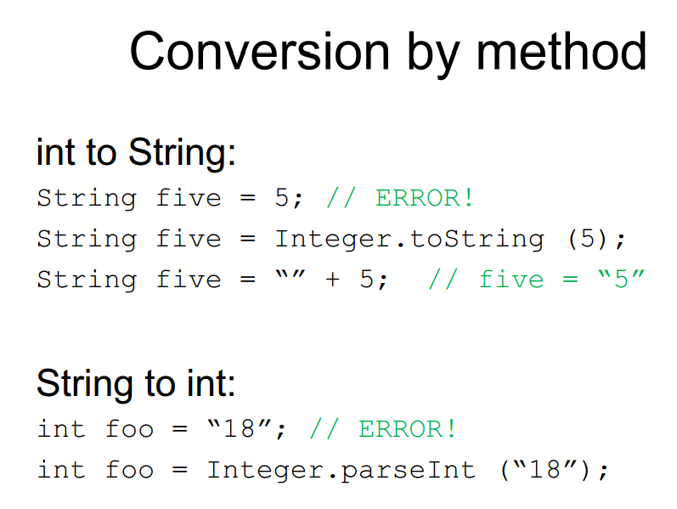

Slide 53
Reading input from console
import java.util.Scanner;
public static void main(String[] args) {
Scanner scanner = new Scanner(System.in);
System.out.println(“Name:”);
String input = scanner.next();
System.out.println(“Hello ”+ input);
scanner.close();
}

Slide 54
Scanner Class
Scanner scan = new Scanner(System.in);
int num = scan.nextInt();
double d = scan.nextDouble();
String s = scan.next();
String s = scan.nextLine();
boolean b = scan.hasNext() (or scan.hasNextInt();)
scan.close();

